Slide 1

Java Project : boulderdash
Paul Boogaerts
Maxence kruger
Valentin Naessens
Alexis Hoyez

Slide 2
Summary
Group presentation
Context & need
Diagram
Functionality
Ways of improvement
Conclusion
Questions

Slide 3
Group presentation
Maxence
Project leader
Gif
Rapport de Projet
Paul
Programmer
Hero’s movement
Alexis
Programmer
Display of the map
Valentin
Diagram
map
Group presentation
Context & need
Diagram
Functionality
Ways of improvement
Conclusion
Questions

Slide 4
Context & need
Group presentation
Context & need
Diagram
Functionality
Ways of improvement
Conclusion
Questions

Slide 5
Context
À remplir
Group presentation
Context & need
Diagram
Functionality
Ways of improvement
Conclusion
Questions

Slide 6
need
Maven
MVC
Database
Game’s constraints
Group presentation
Context & need
Diagram
Functionality
Ways of improvement
Conclusion
Questions

Slide 7
Diagrams
Group presentation
Context & need
Diagram
Functionality
Ways of improvement
Conclusion
Questions

Slide 8
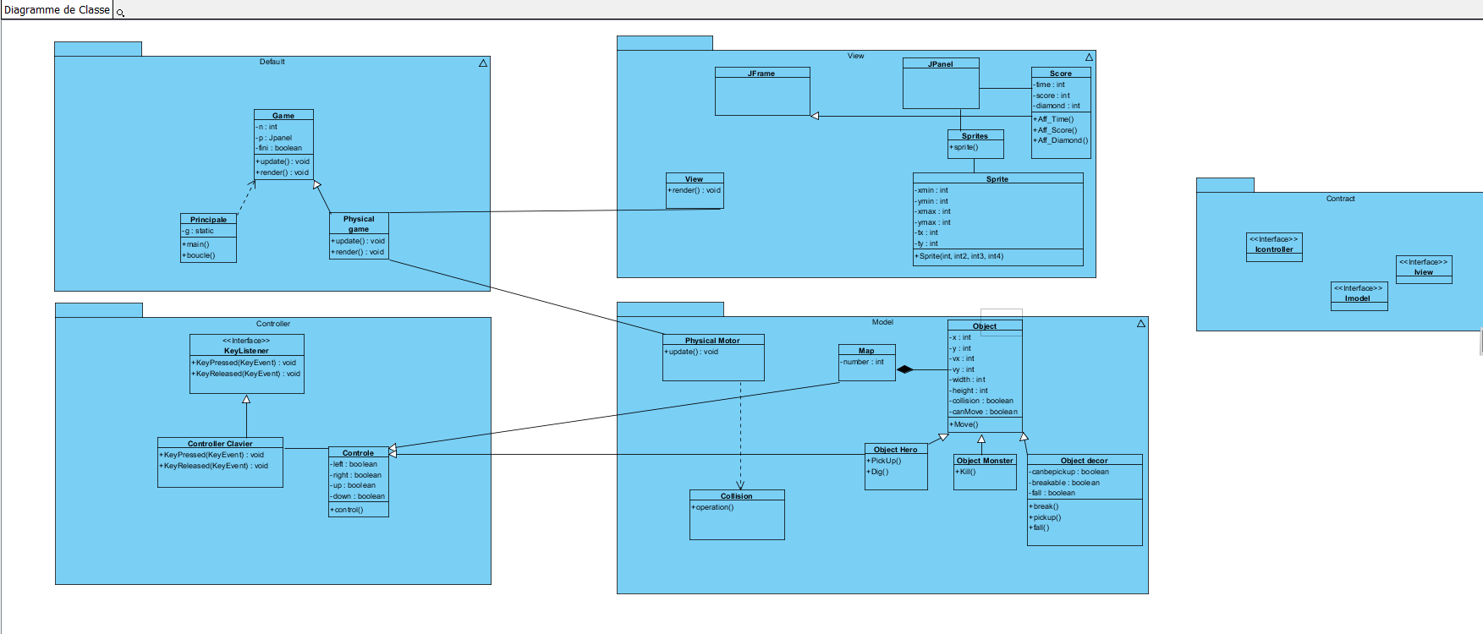
PREDICTIVE class diagram
Group presentation
Context & need
Diagram
Functionality
Ways of improvement
Conclusion
Questions

Slide 9
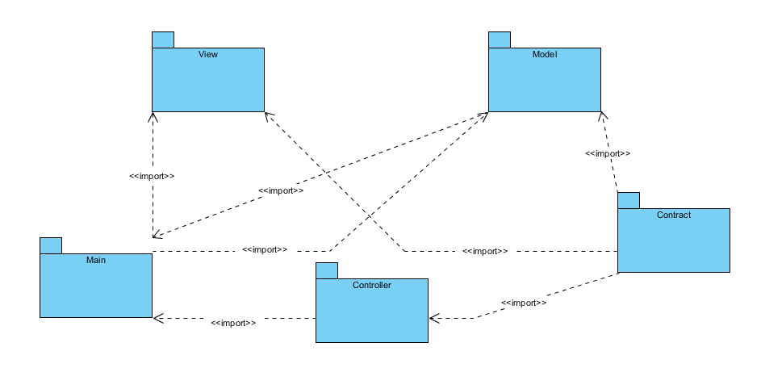
Package diagram
Group presentation
Context & need
Diagram
Functionality
Ways of improvement
Conclusion
Questions

Slide 10
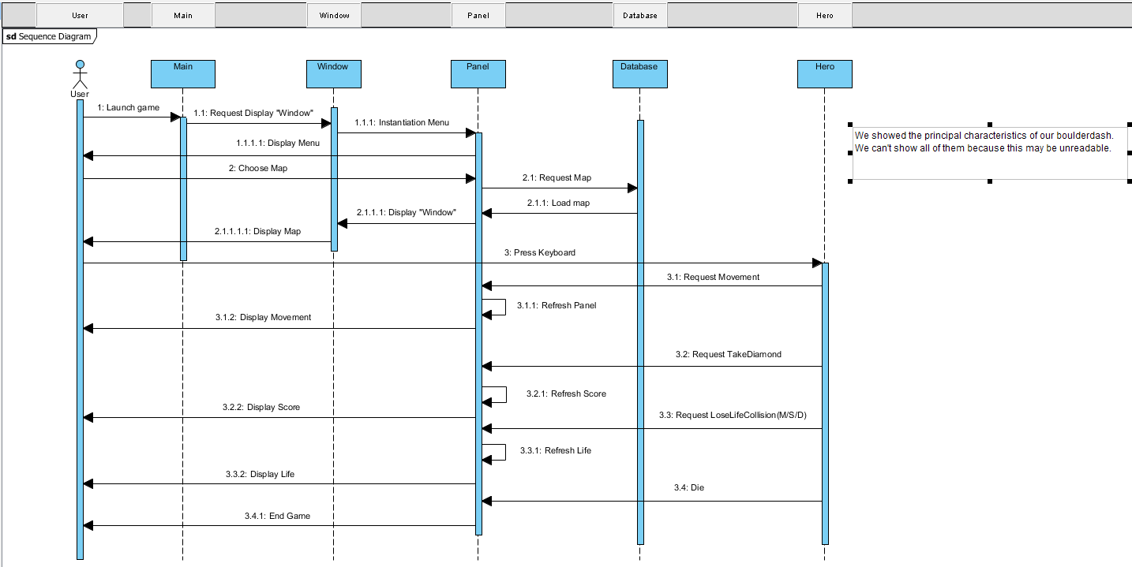
Sequence diagram
Group presentation
Context & need
Diagram
Functionality
Ways of improvement
Conclusion
Questions

Slide 11
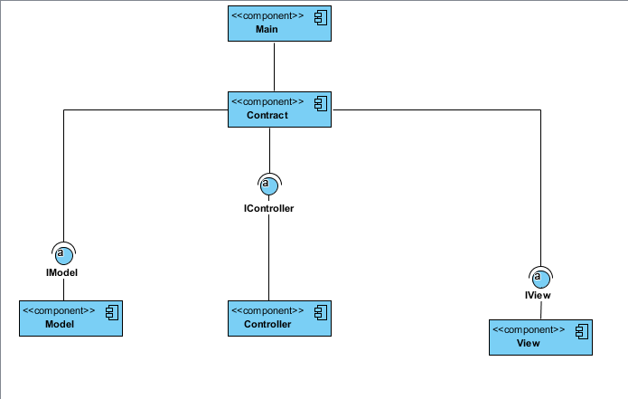
Component diagram
Group presentation
Context & need
Diagram
Functionality
Ways of improvement
Conclusion
Questions

Slide 12
Functionality
Group presentation
Context & need
Diagram
Functionality
Ways of improvement
Conclusion
Questions

Slide 13
MAP
Database //////////////MAP
Matrix
Gif
Refresh
Group presentation
Context & need
Diagram
Functionality
Ways of improvement
Conclusion
Questions

Slide 14
movement
Hero
Monster
Diamond
Stone
Group presentation
Context & need
Diagram
Functionality
Ways of improvement
Conclusion
Questions

Slide 15
???
Si vous voulez rajouté des fonctionnalité auquel je n’ai pas pensé
Group presentation
Context & need
Diagram
Functionality
Ways of improvement
Conclusion
Questions

Slide 16
Ways of improvement
MVC
Unit test
Group presentation
Context & need
Diagram
Functionality
Ways of improvement
Conclusion
Questions

Slide 17
Conclusion
À remplir
Group presentation
Context & need
Diagram
Functionality
Ways of improvement
Conclusion
Questions

Slide 18
questions
Group presentation
Context & need
Diagram
Functionality
Ways of improvement
Conclusion
Questions

